Slide 1
Conceptual Dynamics
Part II: Kinematics of Particles
Chapter 3
Kinematics of Particles
Plane Curvilinear Motion
Projectile Motion

Slide 2
Projectile Motion
What is a projectile?

Slide 3
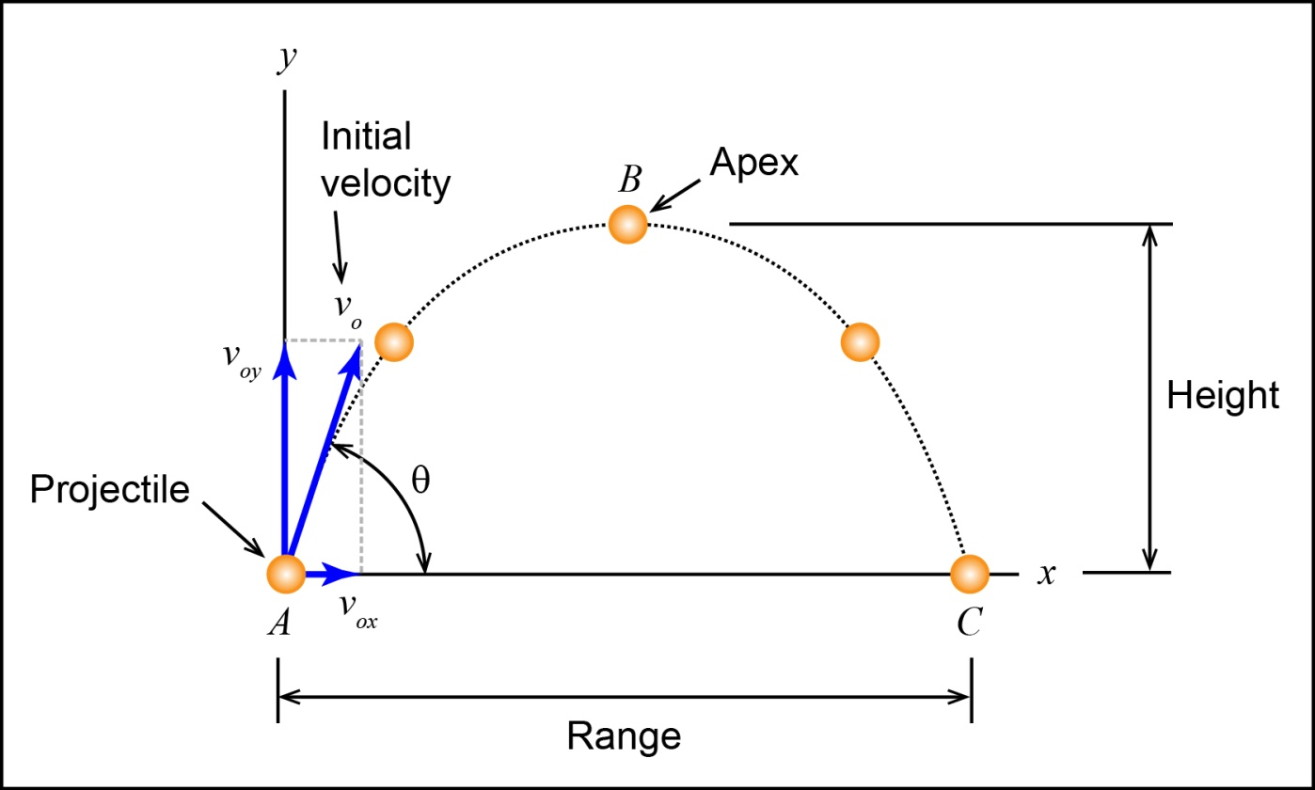
Projectile Motion
What is a projectile?
A particle is given an initial velocity and allowed to move through the air on its own.

Slide 4
Projectile Motion
What is a projectile?
The only force acting on the particle is its weight (if we neglect air resistance).

Slide 5
Falling

Slide 6
Falling
Video: Misconceptions About Falling Objects
http://www.youtube.com/watch?v=aRhkQTQxm4w&sns=em

Slide 7
Conceptual Example 3.2-1
All objects fall with a constant acceleration.
What is this acceleration?

Slide 8
Conceptual Example 3.2-1
All objects fall with a constant acceleration.
What is this acceleration?
The acceleration of gravity (g)

Slide 9
Conceptual Example 3.2-1
Does mass influence a falling object’s velocity?

Slide 10
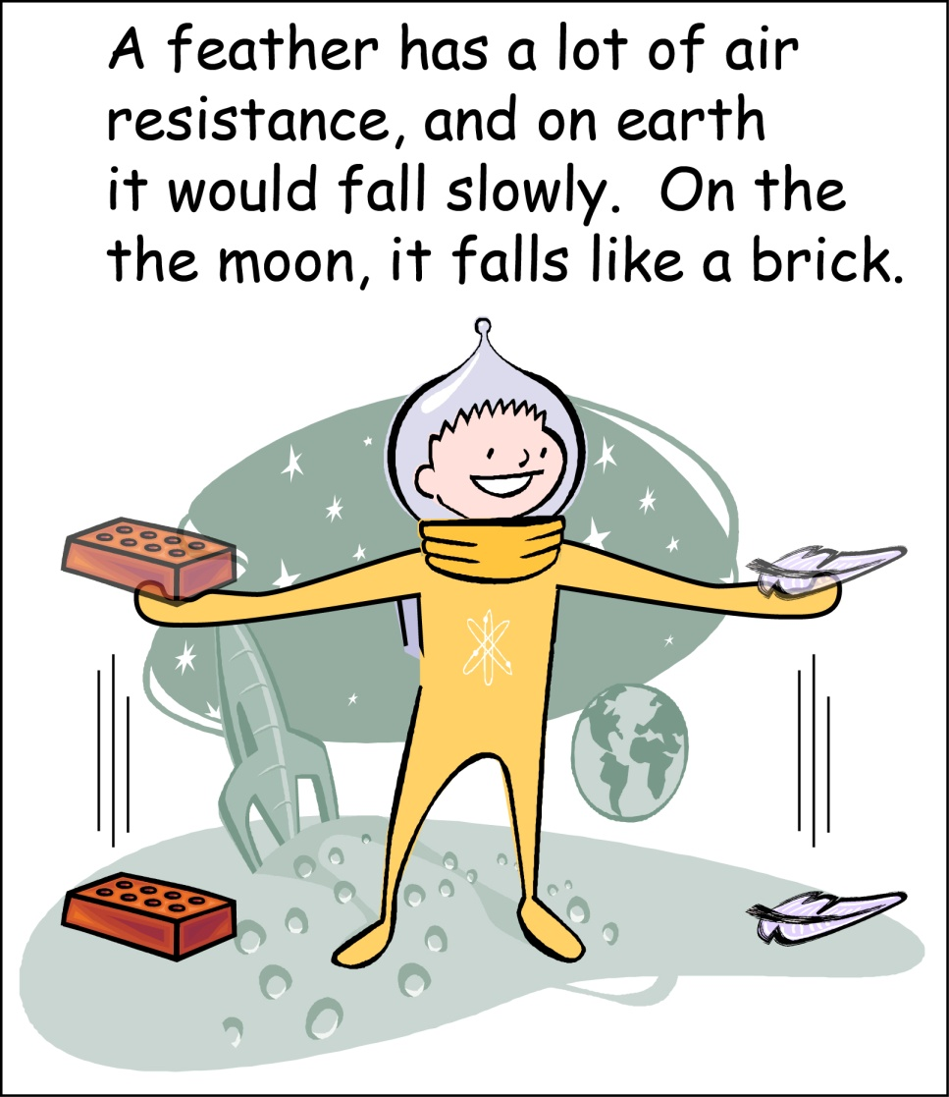
Conceptual Example 3.2-1
Does mass influence a falling object’s velocity?
No

Slide 11
Conceptual Example 3.2-1
When would the size and shape of an object affect the speed at which an object falls?

Slide 12
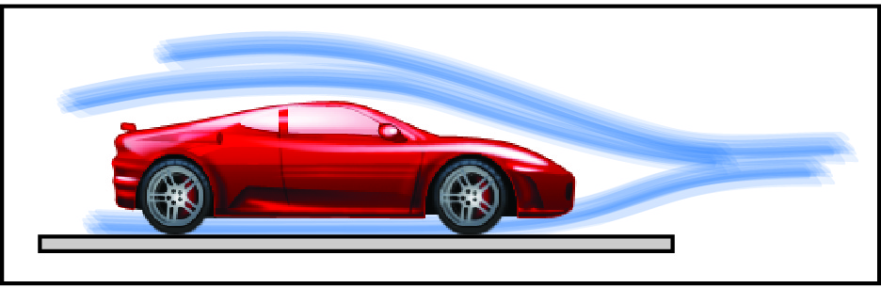
Conceptual Example 3.2-1
When would the size and shape of an object affect the speed at which an object falls?
When air resistance is significant and cannot be neglected.
Magnus Force Video

Slide 13
Solving Projectile Problems
Things to remember.
Motion in the x and y directions are independent.

Slide 14
Solving Projectile Problems
If a man shoots a bullet from the same height and at the same time that a woman shoots an arrow, which will hit the ground first? (neglect air resistance)

Slide 15
Solving Projectile Problems
They will reach the ground at the same time because the acceleration of falling is the same.

Slide 16
Solving Projectile Problems
Things to remember.
The x-dir velocity is constant (no air resistance).

Slide 17
Solving Projectile Problems
Things to remember.
The x-dir velocity is constant (no air resistance).

Slide 18
Solving Projectile Problems
Things to remember.
The y-dir acceleration is constant (no air resistance).

Slide 19
Solving Projectile Problems
Things to remember.
The y-dir velocity is not constant.

Slide 20
Solving Projectile Problems
Things to remember.
The y-dir position.

Slide 21
Solving Projectile Problems
Things to remember.
The y-dir velocity at the apex is zero.

Slide 22
Solving Projectile Problems
Things to remember.
If the starting height of the projectile is the same as the ending height, then the motion of the projectile is symmetric.

Slide 23
Conceptual Example 3.2-2
What is the x-direction acceleration of a projectile?

Slide 24
Solving Projectile Problems
What is the x-direction acceleration of a projectile?

Slide 25
Solving Projectile Problems
What is special about the x-direction velocity of a projectile?

Slide 26
Solving Projectile Problems
What is special about the x-direction velocity of a projectile?

Slide 27
Solving Projectile Problems
What is the y-direction velocity of a projectile at the apex of travel?

Slide 28
Solving Projectile Problems
What is the y-direction velocity of a projectile at the apex of travel?

Slide 29
Solving Projectile Problems
What is the y-direction acceleration of a projectile?

Slide 30
Solving Projectile Problems
What is the y-direction acceleration of a projectile?

Slide 31
Solving Projectile Problems
What is important not to forget about the y-direction velocity of a projectile?

Slide 32
Solving Projectile Problems
What is important not to forget about the y-direction velocity of a projectile?

Slide 33
Conceptual Example 3.2-3
Imagine that you are a passenger in one of those very tall monster trucks. The truck is driving safely at a constant speed down a long straight flat highway. Imagine that you have a ball. Now roll down the truck window and drop the ball outside of the truck. Neglecting air resistance, how does the ball behave before it hits the ground?

Slide 34
Conceptual Example 3.2-3
The truck quick passes the ball up.
The ball and truck travel side-by-side and remain even.
The ball passes the truck.
The ball passes the truck briefly and then starts to lag behind.
Not enough information.

Slide 35
Conceptual Example 3.2-3
The truck quick passes the ball up.
The ball and truck travel side-by-side and remain even.
The ball passes the truck.
The ball passes the truck briefly and then starts to lag behind.
Not enough information.
Without air resistance nothing is causing the ball to slow down in the x-direction.

Slide 36
Conceptual Example 3.2-3
How would your answer change if we took air resistance into account?
The truck quick passes the ball up.
The ball and truck travel side-by-side and remain even.
The ball passes the truck.
The ball passes the truck briefly and then starts to lag behind.
Not enough information.

Slide 37
Conceptual Example 3.2-3
The truck quick passes the ball up.
The ball and truck travel side-by-side and remain even.
The ball passes the truck.
The ball passes the truck briefly and then starts to lag behind.
Not enough information.
With air resistance the ball is being slowed down in the x-direction and the truck remains at its constant speed.

Slide 38
Conceptual Example 3.2-3
How would your answer change if, at the moment the ball was dropped, the driver releases the gas pedal and the truck starts to coast (do not neglect air resistance)?

Slide 39
Conceptual Example 3.2-3
The truck quick passes the ball up.
The ball and truck travel side-by-side and remain even.
The ball passes the truck.
The ball passes the truck briefly and then starts to lag behind.
Not enough information.

Slide 40
Conceptual Example 3.2-3
The truck quick passes the ball up.
The ball and truck travel side-by-side and remain even.
The ball passes the truck.
The ball passes the truck briefly and then starts to lag behind.
Not enough information.
This is more complex that it may appear. The truck has a higher drag coefficient than the ball, but because the truck is heavier, it has more inertia and requires a larger force to slow.

Slide 41
Conceptual Example 3.2-4
If you drop an object, we know that its acceleration is g downward. What happens if, with all your might, you throw an object up? What’s the object’s acceleration after you let go of it?

Slide 42
Conceptual Example 3.2-4
Less than g.
Equal to g.
More than g.
Less than g for a while and then g.
More than g for a while and then g.

Slide 43
Conceptual Example 3.2-4
Less than g.
Equal to g.
More than g.
Less than g for a while and then g.
More than g for a while and then g.

Slide 44
Conceptual Example 3.2-5
Imagine that you and a buddy are standing next to each other holding baseballs. Your buddy throws his baseball up with an initial velocity of 30 mph and you throw your baseball down with an initial velocity of 30 mph from the same initial height. Neglecting air resistance, which ball hits the ground with greater speed?

Slide 45
Conceptual Example 3.2-5
your ball.
your buddy’s ball
both your ball and your buddy’s ball hit the ground with the same speed.

Slide 46
Conceptual Example 3.2-5
your ball.
your buddy’s ball
both your ball and your buddy’s ball hit the ground with the same speed.

Slide 47
Example Problems
EP3.2-6
EP3.2-7 (Video)
EP3.2-8

